Slide 1




MUSIC STORE - SQL ANALYSIS PROJECT
PROJECT BY - ANURAG DAS

Slide 2

Project Overview & Business Goals
This project is based on a fictional music store database, which includes data on customers, employees, invoices, tracks, artists, albums, genres, media types, and playlists.
Business Goals
To uncover key insights related to customer spending, music preferences, and artist performance across music genre ,countries.

Slide 3
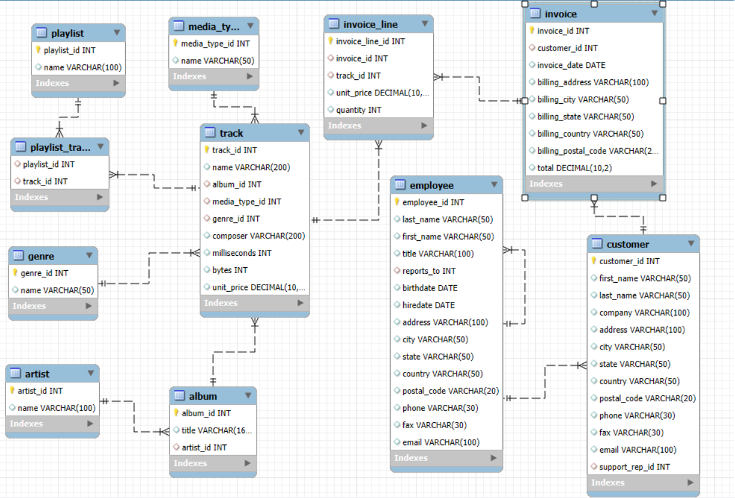
SCHEMA DIAGRAM

Slide 4
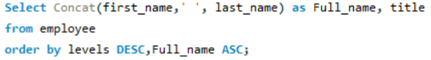
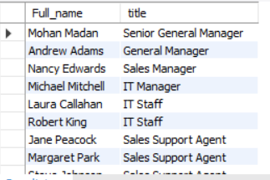
Find the most senior employee based on job title.

Slide 5
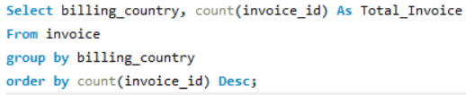

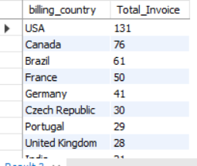
Determine which countries have the most invoices.

Slide 6
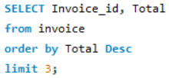

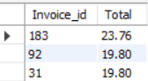
Identify the top 3 invoice totals.

Slide 7

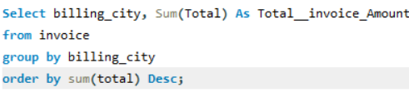
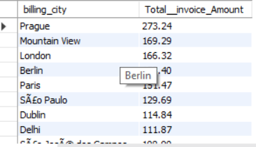
Find the city with the highest total invoice amount to determine the best location for a promotional event.

Slide 8
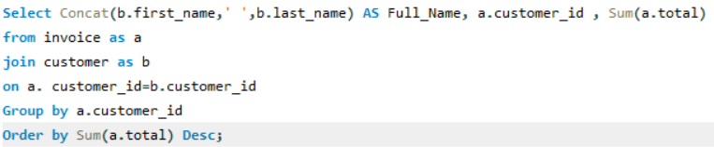

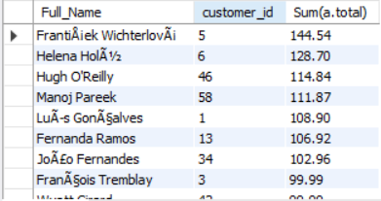
Identify the customer who has spent the most money.

Slide 9
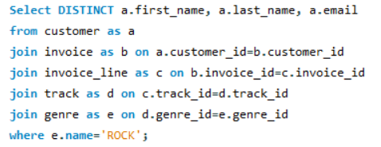
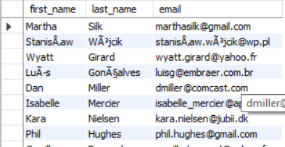
Find the email, first name, and last name of customers who listen to Rock music.

Slide 10
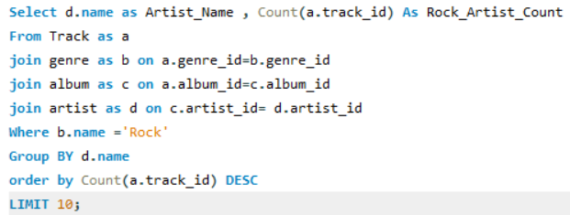

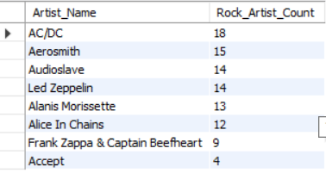
Identify the top 10 rock artists based on track count.

Slide 11
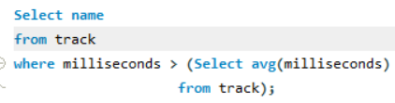

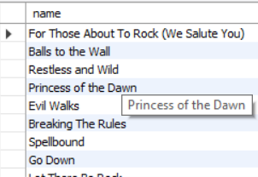
Find all track names that are longer than the average track length.

Slide 12
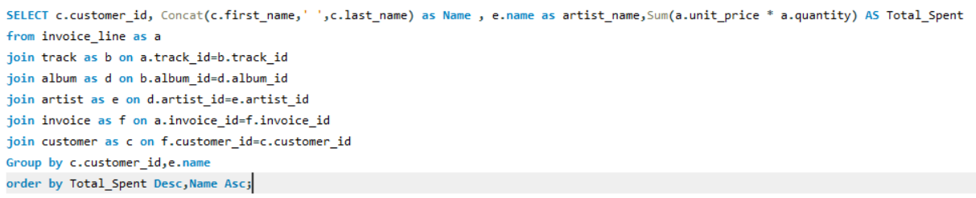
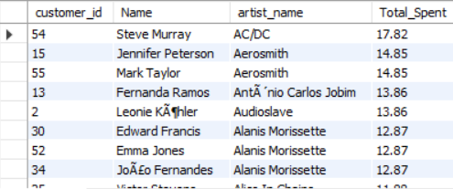
Calculate how much each customer has spent on each artist.

Slide 13
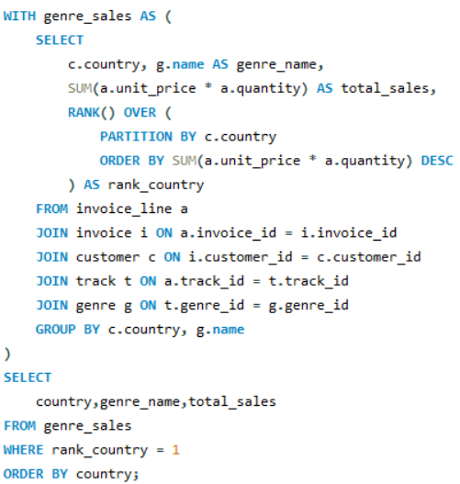
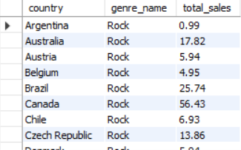
Determine the most popular music genre for each country based on purchases.

Slide 14
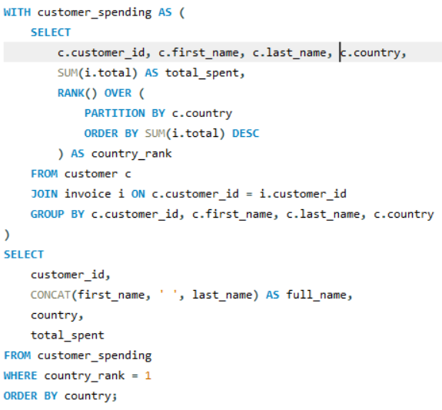
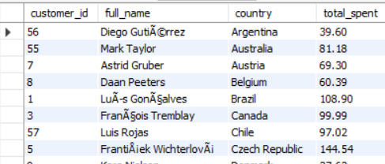
Identify the top-spending customer for each country.

Slide 15
Thank you
Linkedin : linkedin.com/in/anuragdas3

